Slide 1
ECE 480
Wireless Systems
Lecture 14
Problem Session
26 Apr 2006

Slide 2
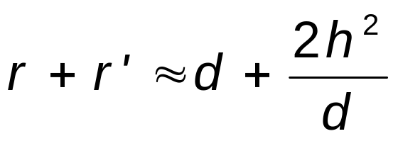
Problem 3.1
Consider-ray channel consisting of a direct ray plus a ground – reflected ray where the transmitter is a fixed base station at height h and the receiver is mounted on a truck (also at a height, h. The truck starts next to the base station and moves away at velocity υ. Assume that signal attenuation on each path follows a free – space path – loss model. Find the time – varying channel impulse at the receiver tot transmitter – receiver separation d = υ t sufficiently large for the length of the reflected ray to be approximated by

Slide 3
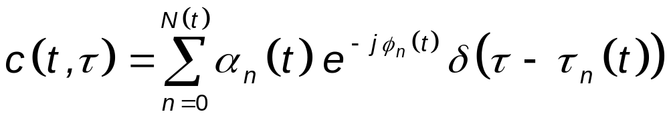
Solution
Equivalent low-pass channel impulse response
LOS
Reflected

Slide 4
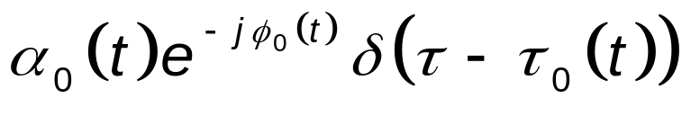
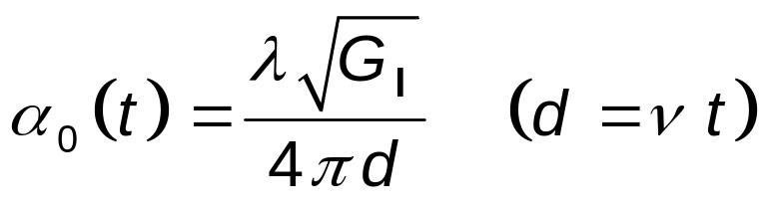
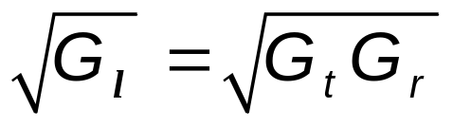
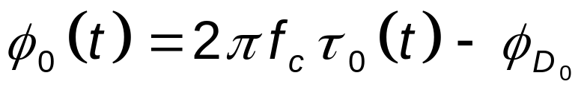
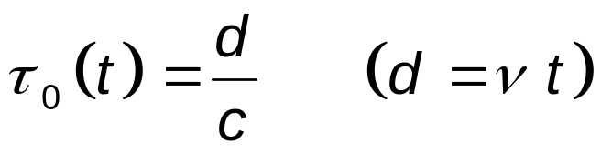
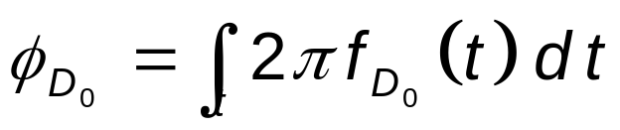
Parameters of the LOS term
LOS

Slide 5
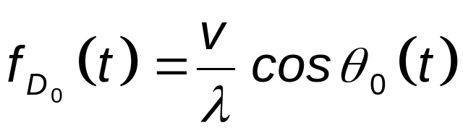
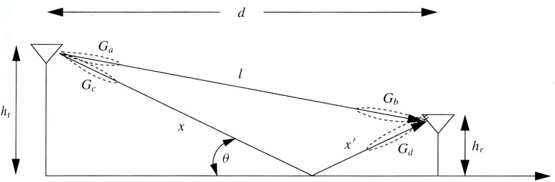
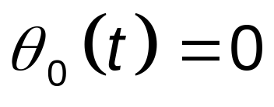

Slide 6
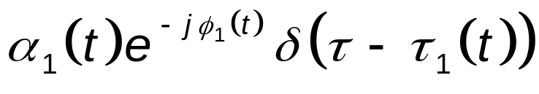
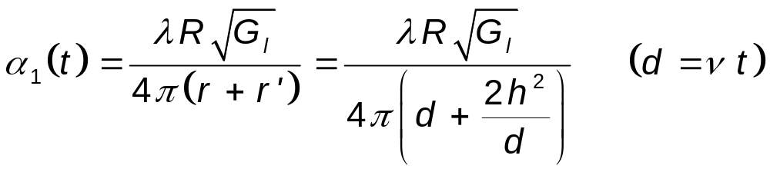
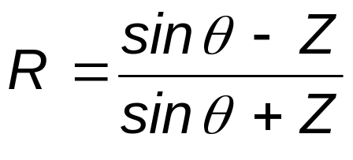
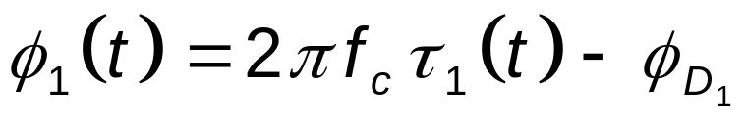
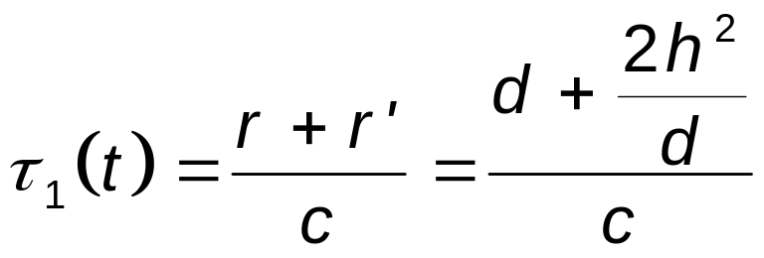
Parameters of the Reflected Term
R = Ground reflection coefficient

Slide 7
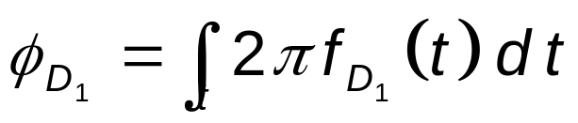
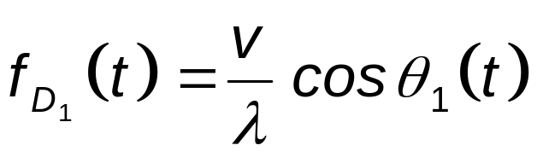
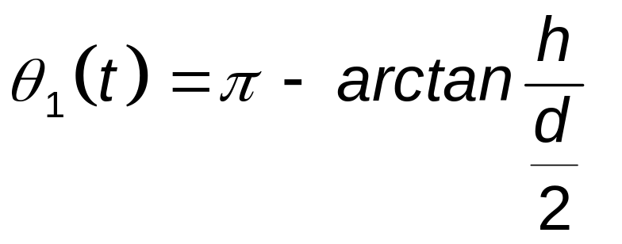

Slide 8

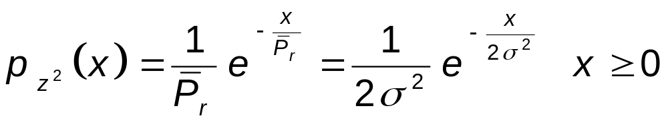
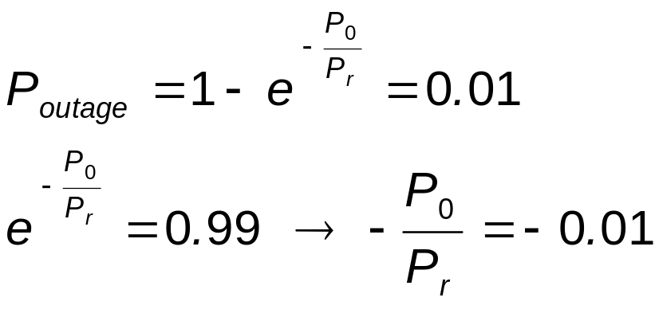
Problem 3.7
Suppose we have an application that requires a power outage probability of 0.01 for the threshold P ₀ = - 80 dBm. For Rayleigh fading, what value of the average signal power is required?
Solution

Slide 9
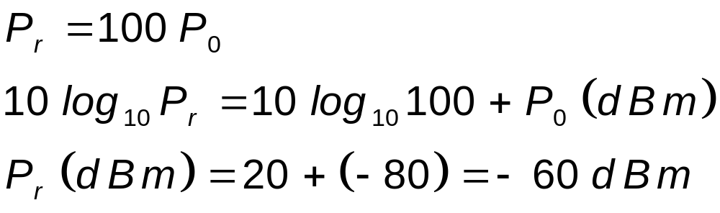

Slide 10
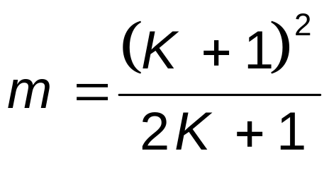
Problem 3.9
This problem illustrates that the tails of the Rician distribution can be quite different than its Nakagami approximation. Plot the cumulative distribution function (cdf) of the Rician distribution for K = 1, 5, 10 and the corresponding Nakagami distribution with
In general, does the Rician distribution or its Nakagami approximation have a larger outage probability p (γ < x) for x large?

Slide 11
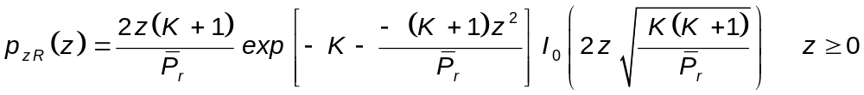
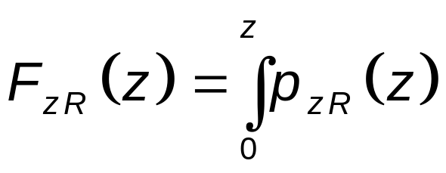
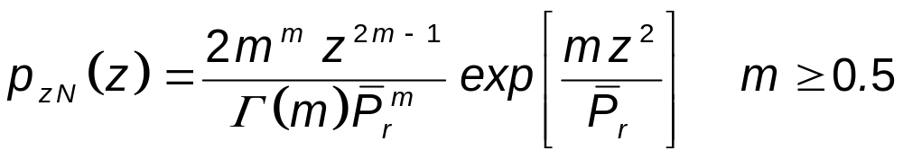
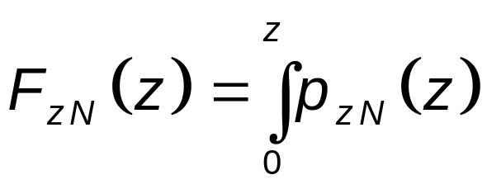
Solution
For the Rician distribution:
For the Nakagami-m distribution

Slide 12

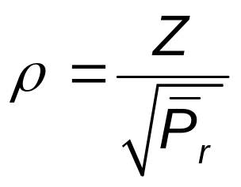
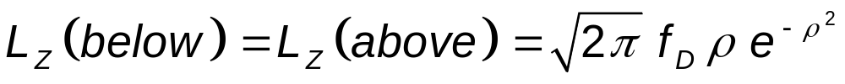
Problem 3.13
Derive a formula for the average length of time that a Rayleigh fading process with average power stays above a given target fade value P ₀. Evaluate this average length of time for = 20 dB, P ₀ = 25 dB and f _{D} = 50 Hz.
Solution
For Rayleigh fading (K = 0):
Z = Target level = 25 dB

Slide 13
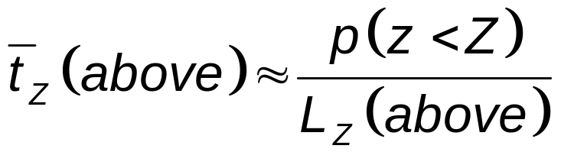
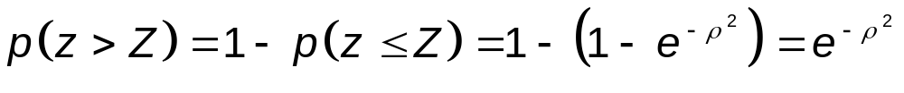
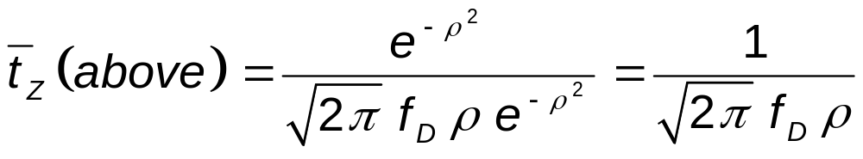
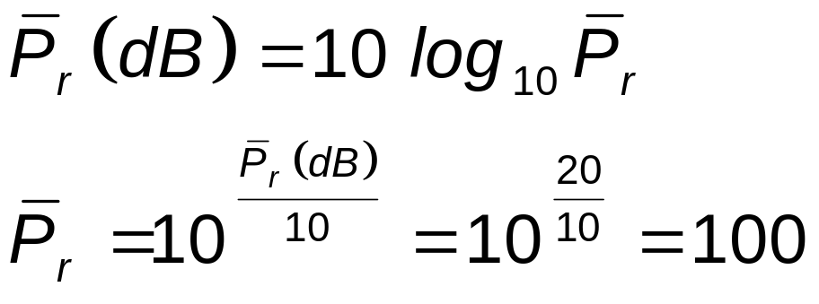

Slide 14
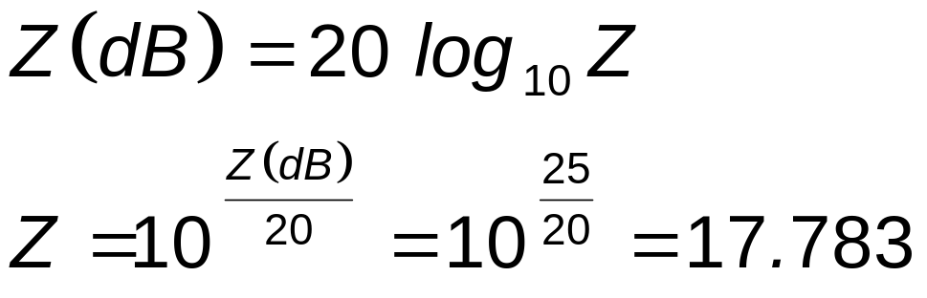
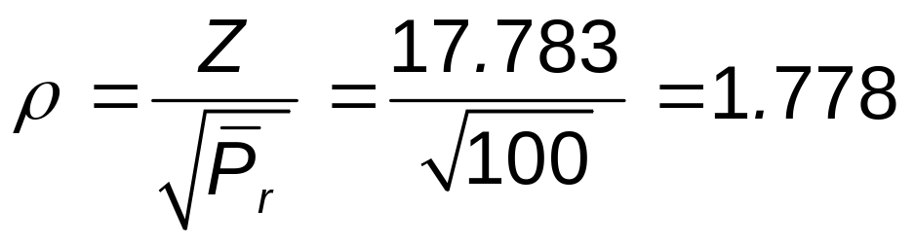
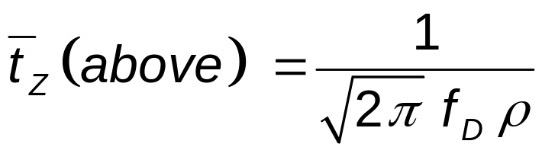

Slide 15
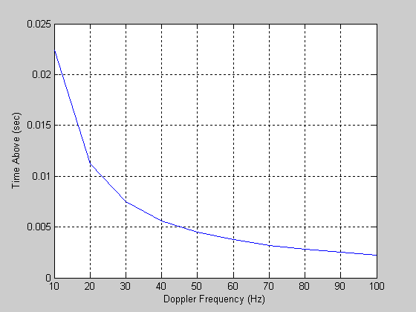

Slide 16
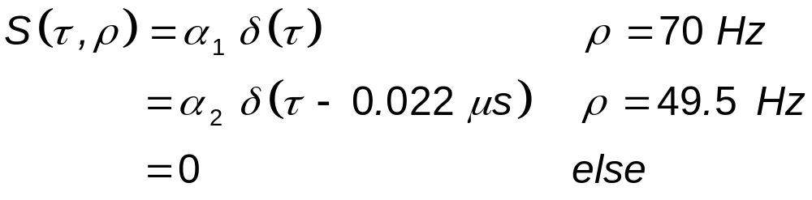
Problem 3.15
Consider the following channel scattering function obtained by sending a 900 MHz signal sinusoidal input into the channel:
where α ₁ and α ₂ are determined by path loss, shadowing, and multipath fading. Clearly this scattering function corresponds to a two – ray model. Assume the transmitter and receiver used to send and receive the sinusoid are located 8 m above the ground.

Slide 17
Find the distance and velocity between the transmitter and receiver
For the distance computed in part (a), is the path loss as a function of distance proportional to d ^{– 2} or d – 4?
Does a 30 KHz voice signal transmitted over this channel experience flat or rather frequency – selective fading?

Slide 18
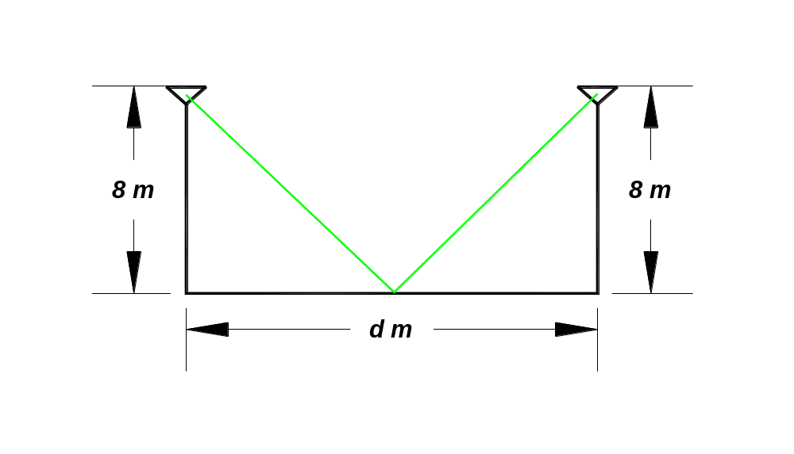
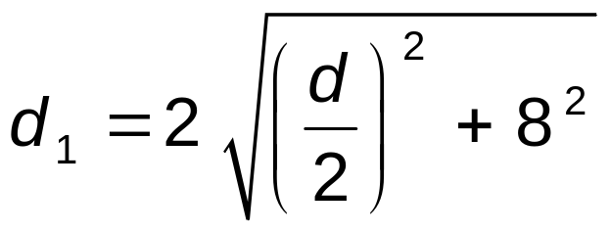
Solution
(a)
Distance traveled by LOS component = d
Distance traveled by first multipath component

Slide 19
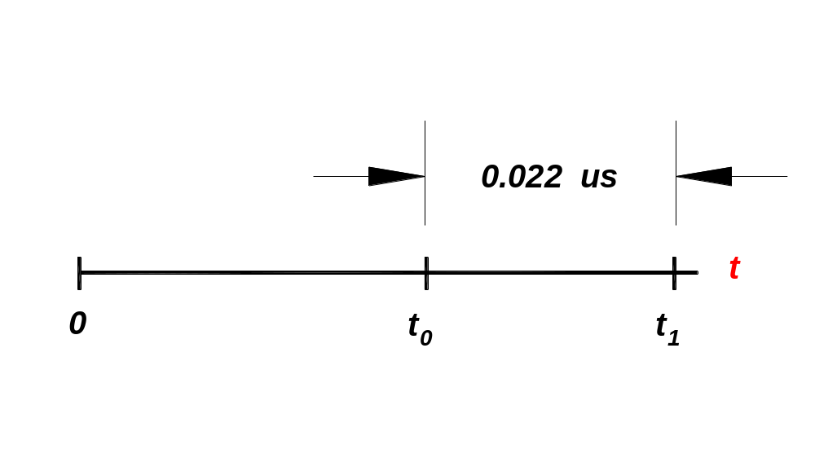
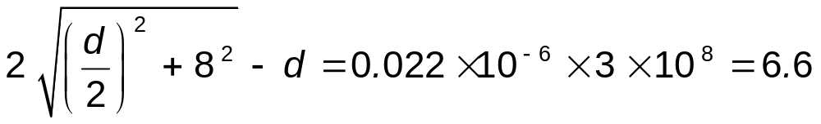
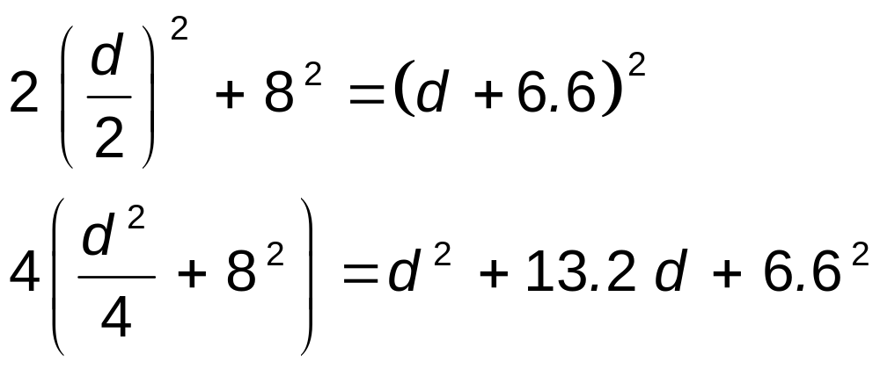
Square both sides

Slide 20
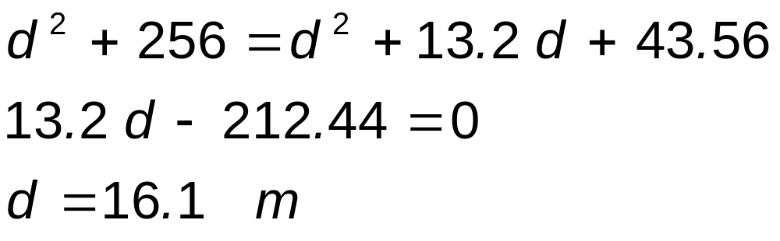
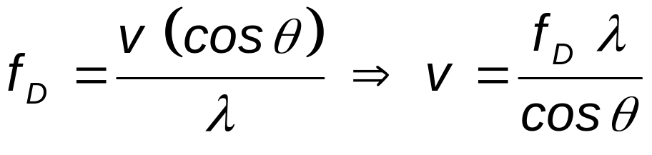
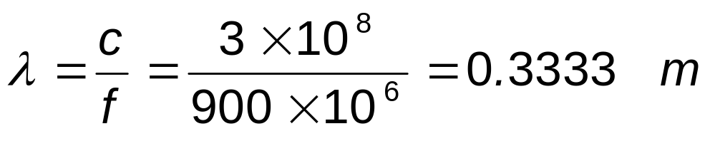
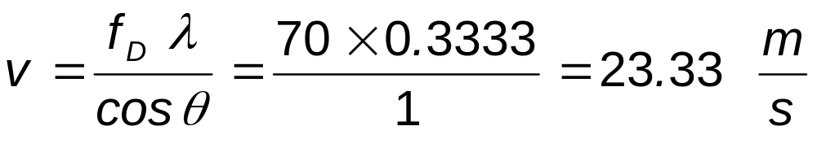
LOS component: θ = 0 º , f _{D} = 70 Hz

Slide 21
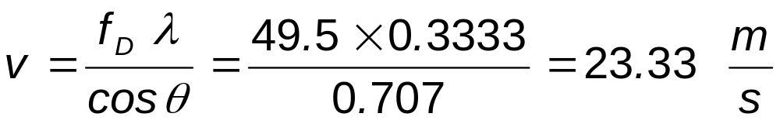
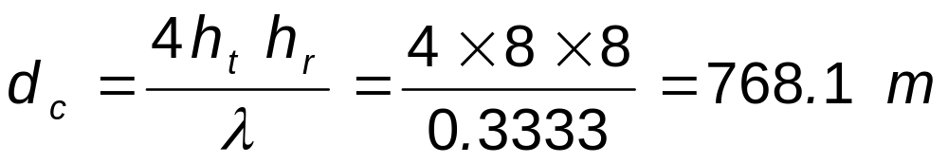
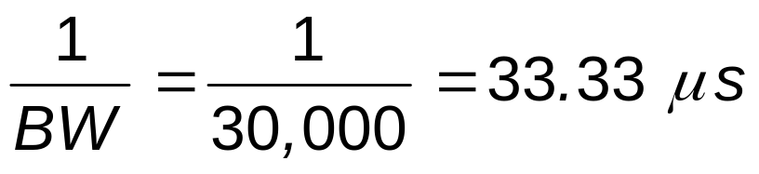

Multipath component: θ = 45 º , f _{D} = 49.5 Hz
b.
d _{c} >> d: ∴ power fall – off is proportional to d ⁻ ²
c.
f = 30 khz
∴ We have flat fading

Slide 22
Problem 3.17
Let a scattering function S _{c} (τ , ρ) be nonzero over 0 ≤ τ ≤ 0.1 ms and – 0.1 ≤ ρ ≤ 0.1 Hz. Assume that the power of the scattering function is approximately uniform over the range where it is nonzero.
a. What are the multipath spread and the Doppler spread of the channel?
b. Suppose you input to this channel two identical sinusoids separated in frequency by Δ f. What is the minimum value of Δ f for which the channel response to the first sinusoid is approximately independent of the channel response to the second sinusoid?

Slide 23
c. For two sinusoidal inputs to the channel u ₁ (t) = sin 2π f t and u ₂ (t) = sin 2π f (t + Δ t) find the minimum value of Δ t for which the channel response to u ₁ (t) is approximately independent of the channel response to u ₂ (t)?
d. Will this channel exhibit flat fading or frequency – selective fading for a typical voice channel with a 3 KHz bandwidth? For a cellular channel with a 30 KHz bandwidth?

Slide 24

Solution
a. What are the multipath spread and the Doppler spread of the channel?
T _{m} ≈ range of definition ≈ 0.1 msec = 100 μ sec

Slide 25

b. Suppose you input to this channel two identical sinusoids separated in frequency by Δ f. What is the minimum value of Δ f for which the channel response to the first sinusoid is approximately independent of the channel response to the second sinusoid?
f ₂ must be out of the bandwidth of f ₁
Δ f > 10 KHz for independence

Slide 26

c. For two sinusoidal inputs to the channel u ₁ (t) = sin 2π f t and u ₂ (t) = sin 2π f (t + Δ t) find the minimum value of Δ t for which the channel response to u ₁ (t) is approximately independent of the channel response to u ₂ (t)?
d. Will this channel exhibit flat fading or frequency – selective fading for a typical voice channel with a 3 KHz bandwidth? For a cellular channel with a 30 KHz bandwidth?
3 kHz < B _{c} : Flat fading
30 kHz > B _{c} : Frequency selective fading

Slide 27


Problem 4.2
Consider an AWGN channel with bandwidth 50 MHz, received signal power 10 mW, and noise PSD N ₀ /2 where N ₀ = 2 × 10 ^{– 9} W/Hz. How much does capacity increase by doubling the received power? How much does capacity increase by doubling the channel bandwidth?
Solution

Slide 28



Double Power

Slide 29


Double Bandwidth
Noise level is increased as well

Slide 30

Problem 4.4
Consider a flat fading channel of bandwidth 20 MHz and where, for a fixed transmit power , the received SNR is one of six values: γ ₁ = 20 dB, γ ₂ = 15 dB, γ ₃ = 10 dB, γ ₄ = 0.5 dB, γ ₅ = 0 dB, and γ ₆ = - 5 dB. The probabilities associated with each state are p ₁ = p ₆ = 0.1, p ₂ = p ₄ = 0.15, and p ₃ = p ₅ = 0.25. Assume that only the receiver has CSI.
a. Find the Shannon capacity of this channel
b. Plot the capacity vs. outage for 0 ≤ P _{out} ≤ 1 and find the maximum average rate that can be correctly received (maximum C _{out})

Slide 31


Solution
Must convert γ to power
γ ₁ = 100, γ ₂ = 31.623, γ ₃ = 10, γ ₄ = 3.1623, γ ₅ = 1, and γ ₆ = 0.3162.

Slide 32

a. Ergodic Capacity

Slide 33




b. Capacity vs. Outage

Slide 34


p 1 = p 6 = 0.1, p 2 = p 6 = 0.15, and p 3 = p 5 = 0.25.
γ ₁ = 100, γ ₂ = 31.623, γ ₃ = 10, γ ₄ = 3.1623, γ ₅ = 1, and γ ₆ = 0.3162.

Slide 35


p 1 = p 6 = 0.1, p 2 = p 6 = 0.15, and p 3 = p 5 = 0.25.
γ ₁ = 100, γ ₂ = 31.623, γ ₃ = 10, γ ₄ = 3.1623, γ ₅ = 1, and γ ₆ = 0.3162.

Slide 36



Slide 37


Problem 4.5
Consider a flat fading channel in which, for a fixed transmit power , the received SNR is one of four values: γ ₁ = 30 dB, γ ₂ = 20 dB, γ ₃ = 10 dB, and γ ₄ = 0 dB, and the probabilities associated with each state are p ₁ = 0.2, p ₂ = 0.3, p ₃ = 0.3, and p ₄ = 0.2. Assume that both transmitter and receiver have CSI.
Find the optimal power adaptation policy for this channel and its corresponding Shannon capacity per unit Hertz (C/B)
Find the channel inversion power adaptation policy for this channel and associated zero – outage capacity per unit bandwidth

Slide 38

c. Find the truncated channel inversion power adaptation policy for this channel and associated outage capacity per unit bandwidth for three different outage probabilities P _{out} = 0.1, P _{out} = 0.25, and P _{out} (and the associated cutoff γ ₀) equal to the value that achieves maximum outage capacity
Solution
a.
Assume that all channels are used
Convert γ to magnitudes
γ ₁ = 1000, γ ₂ = 100, γ ₃ = 10, and γ ₄ = 1

Slide 39


∴ Our assumption is valid

Slide 40





γ = 1000:
γ = 100:
γ = 10:
γ = 1:

Slide 41





b. Channel inversion power adaptation policy

Slide 42




γ = 1000:
γ = 100:
γ = 10:
γ = 1:

Slide 43



c. Truncated power capacity
The control policy is the same as for the channel inversion case

Slide 44




P _{out} = 0.1:
Must omit channel four : Otherwise,

Slide 45




Slide 46



P _{out} = 0.25:
Must omit channels 3 and 4 : Otherwise,

Slide 47



Max value

Slide 48


Problem 4.7
Assume a Rayleigh fading channel where the transmitter have CSI and the distribution of the fading SNR p (γ) is exponential with mean = 10 dB. Assume a channel bandwidth of 10 MHz.
a. Find the cutoff value and the corresponding power adaptation that achieves Shannon capacity on this channel
b. Compute the Shannon capacity of this channel
c. Compare your answer in part (b) with the channel capacity in AWGN with the same average SNR
d. Compare your answer in part (b) with the Shannon capacity when only the receiver knows γ [i]

Slide 49
e. Compare your answer in part (b) with the zero – outage capacity and outage capacity when the outage probability is 0.05
f. Repeat parts (b), (c), and (d) – that is, obtain the Shannon capacity with perfect transmitter and receiver side information, in AWGN for the same average power, and with just receiver side information – for the same fading distribution but with mean = - 5 dB. Describe the circumstances under which a fading channel has higher capacity than an AWGN channel with the same average SNR and explain why this behavior occurs.

Slide 50



Solution
a. Find the cutoff value and the corresponding power adaptation that achieves Shannon capacity on this channel
For a Rayleigh fading channel, the probability p (γ) is exponential

Slide 51


Slide 52
clear
clc
x=[0.767:0.0001:0.768];
y=x;
n=length(x);
for i=1:1:n
y(i)=(1/(x(i)))*exp(-x(i)/10)-(1/10)*expint(x(i)/10);
end
y
x
y =
1.0009
1.0008
1.0006
1.0005
1.0003
1.0001
1.0000
0.9998
0.9997
0.9995
0.9994
x =
0.7670
0.7671
0.7672
0.7673
0.7674
0.7675
0.7676
0.7677
0.7678
0.7679
0.7680
γ ₀ = 0.7676

Slide 53



b. Compute the Shannon capacity of this channel

Slide 54
clear
clc
x=[0.7676:0.01:1];
n=length(x);
for i=1:1:n
I1(i)=log(x(i)/0.7676)*exp(-x(i)/10)*0.01;
end
Sum1=sum(I1(i))
x1=[1:0.1:10];
n1=length(x1);
for i=1:1:n1
I2(i)=log(x1(i)/0.7676)*exp(-x1(i)/10)*0.1;
end
Sum2=sum(I2(i))
Sum = Sum1+Sum2

Slide 55


c. Compare your answer in part (b) with the channel capacity in AWGN with the same average SNR
d. Compare your answer in part (b) with the Shannon capacity when only the receiver knows γ [i]

